Slide 1
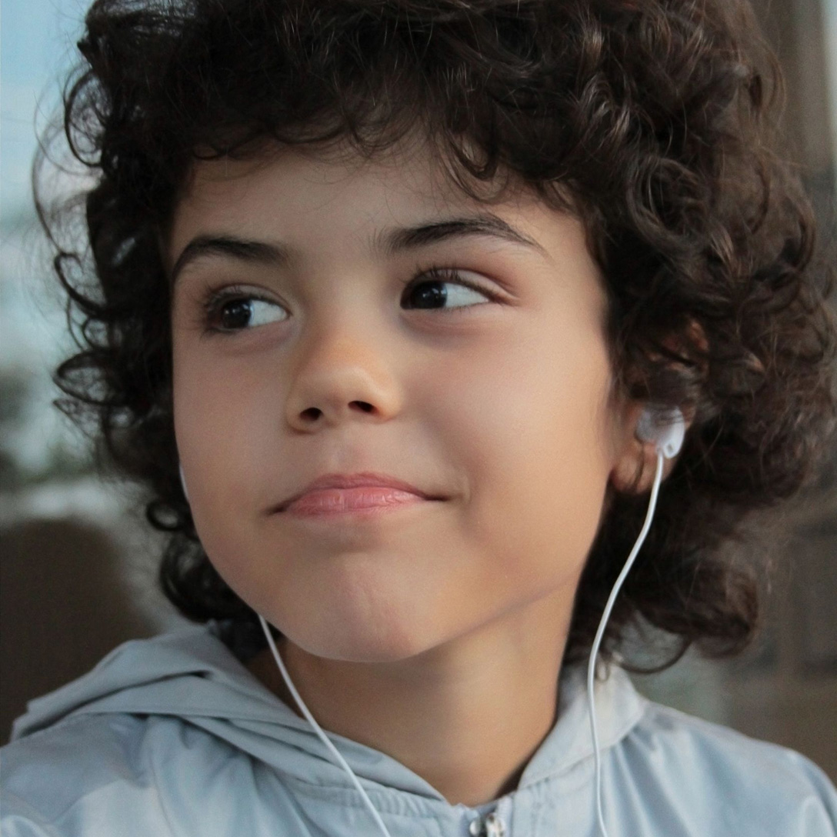
What Sound Is It? K-1: The Senses Teacher’s Guide
Barbara Z. Tharp, MS
Michael T. Vu, MS
Delinda K. Mock, BA
Christopher Burnett, BA
Nancy P. Moreno, PhD
Center for Educational Outreach
Baylor College of Medicine
Photo © Diana Dimitrova.
Notes:
“What Sound Is It?”
Audio files for use with the activity, “Our Sense of Hearing,” from The Learning Brain project’s K–1: The Senses Teacher’s Guide.
Guiding Question
What causes sound? How do our ears detect sound? How does our brain recognize sound?
Concepts
All of the senses are connected to the brain.
Our senses let us know what is going on inside and outside our bodies.
Our sense of hearing allows us to detect sounds.
Sound is produced by vibration.
Objects vibrate when they move back and forth in a regular fashion.
Information about sound is collected by sensory receptors in the ears and transmitted to the brain.
Materials
Teacher
LCD projector and computer or whiteboard
What Sound Is It?” slide set (http://www.bioedonline.org/lessons-and-more/teacher-guides/k-1-the-senses/
Per Student
Copy of both “What Sound Is It?” pages from the activity, “Our Sense of Hearing,” K-1: The Senses Teacher’s Guide
Setup
Load the slide set “What Sound Is It,” which contains audio files. Adjust the sound level for students to hear.
Procedure
Give each student a copy of both “What Sound Is It?” pages. Tell students that you will be playing some sounds, but instruct them not to shout out answers about what they hear. Instead, students should circle the picture that best represents each sound.
Play sounds from the “What Sound Is It?” slide set (slides 1-6).
After the students have listened to all the sounds, lead a class discussion in which they share their answers.
Review the correct answers with the class (see “Answers,” final slide).
Reference
Tharp, B., M. Vu, D. Mock, C. Burnett, and N. Moreno (2015). K-1: The Senses Teacher’s Guide. Baylor College of Medicine. ISBN: 978-1-888997-87-3. Development of The Learning Brain educational materials was supported by grant number 5R25DA033006 from the National Institutes of Health, NIH Blueprint for Neuroscience Research Science Education Award, National Institute on Drug Abuse (NIDA), administered through the Office of the Director, Science Education Partnership Award program.
Image Reference
Photo © Diana Dimitrova.
Key Words
ear, hear, hearing, sound, senses,
“What Sound Is It?” © Baylor College of Medicine.

Slide 2
1. What Made This Sound?
Ambulance
Fire Truck
Ice Cream Truck
Notes:
“What Sound Is It?”
Audio files for use with the activity, “Our Sense of Hearing,” from The Learning Brain project’s K–1: The Senses Teacher’s Guide.
Reference
Tharp, B., M. Vu, D. Mock, C. Burnett, and N. Moreno (2015). K-1: The Senses Teacher’s Guide. Baylor College of Medicine. ISBN: 978-1-888997-87-3. Development of The Learning Brain educational materials was supported by grant number 5R25DA033006 from the National Institutes of Health, NIH Blueprint for Neuroscience Research Science Education Award, National Institute on Drug Abuse (NIDA), administered through the Office of the Director, Science Education Partnership Award program.
Image Reference
Vehicles © Siamphotos.
Key Words
ear, hear, hearing, sound, senses,
“What Sound Is It?” © Baylor College of Medicine.

Slide 3
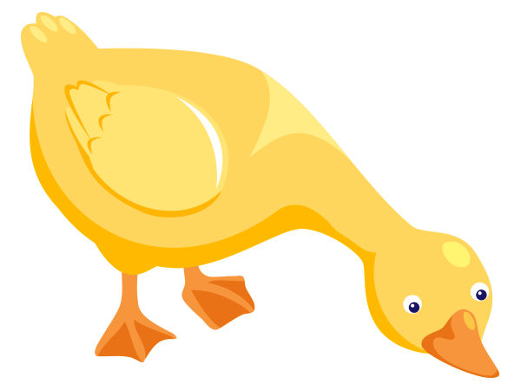
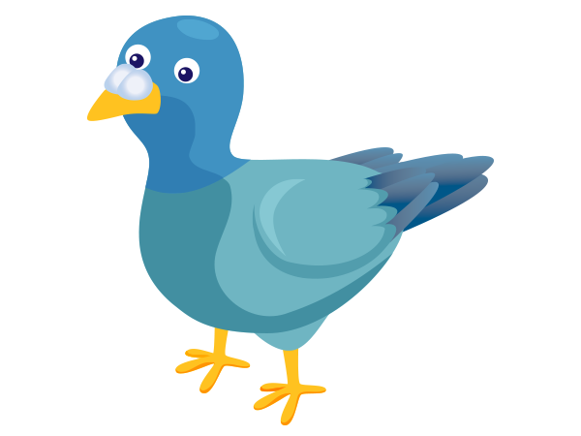
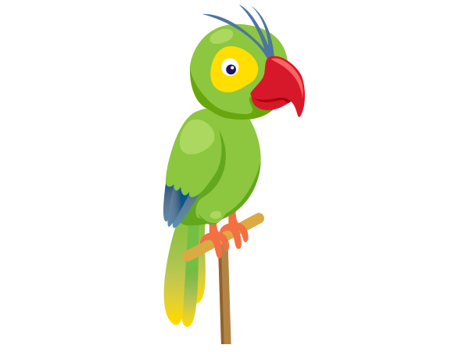
2. What Made This Sound?
Duck
Pigeon
Parrot
Notes:
“What Sound Is It?”
Audio files for use with the activity, “Our Sense of Hearing,” from The Learning Brain project’s K–1: The Senses Teacher’s Guide.
Reference
Tharp, B., M. Vu, D. Mock, C. Burnett, and N. Moreno (2015). K-1: The Senses Teacher’s Guide. Baylor College of Medicine. ISBN: 978-1-888997-87-3. Development of The Learning Brain educational materials was supported by grant number 5R25DA033006 from the National Institutes of Health, NIH Blueprint for Neuroscience Research Science Education Award, National Institute on Drug Abuse (NIDA), administered through the Office of the Director, Science Education Partnership Award program.
Image Reference
Animals © Sarawut Padungkwan.
Key Words
ear, hear, hearing, sound, senses,
“What Sound Is It?” © Baylor College of Medicine.

Slide 4
3. What Made This Sound?
Pond
Beach
Waterfall
Notes:
“What Sound Is It?”
Audio files for use with the activity, “Our Sense of Hearing,” from The Learning Brain project’s K–1: The Senses Teacher’s Guide.
Reference
Tharp, B., M. Vu, D. Mock, C. Burnett, and N. Moreno (2015). K-1: The Senses Teacher’s Guide. Baylor College of Medicine. ISBN: 978-1-888997-87-3. Development of The Learning Brain educational materials was supported by grant number 5R25DA033006 from the National Institutes of Health, NIH Blueprint for Neuroscience Research Science Education Award, National Institute on Drug Abuse (NIDA), administered through the Office of the Director, Science Education Partnership Award program.
Image References
Beach, pond © Iimages.
Waterfall © Natalia Perevozchikova.
Key Words
ear, hear, hearing, sound, senses,
“What Sound Is It?” © Baylor College of Medicine.

Slide 5
4. What Made This Sound?
Garbage Truck
Fire Truck
Helicopter
Notes:
“What Sound Is It?”
Audio files for use with the activity, “Our Sense of Hearing,” from The Learning Brain project’s K–1: The Senses Teacher’s Guide.
Reference
Tharp, B., M. Vu, D. Mock, C. Burnett, and N. Moreno (2015). K-1: The Senses Teacher’s Guide. Baylor College of Medicine. ISBN: 978-1-888997-87-3. Development of The Learning Brain educational materials was supported by grant number 5R25DA033006 from the National Institutes of Health, NIH Blueprint for Neuroscience Research Science Education Award, National Institute on Drug Abuse (NIDA), administered through the Office of the Director, Science Education Partnership Award program.
Image Reference
Vehicles © Siamphotos.
Key Words
ear, hear, hearing, sound, senses,
“What Sound Is It?” © Baylor College of Medicine.

Slide 6
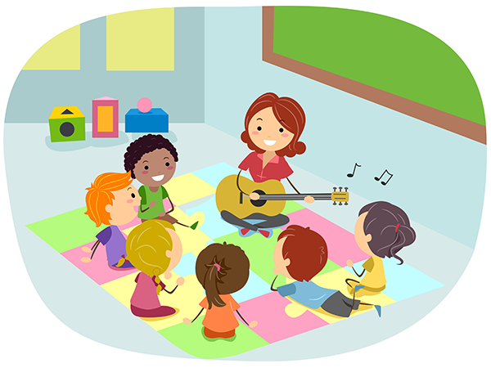
5. What Made This Sound?
Recess
Art
Music
Notes:
“What Sound Is It?”
Audio files for use with the activity, “Our Sense of Hearing,” from The Learning Brain project’s K–1: The Senses Teacher’s Guide.
Reference
Tharp, B., M. Vu, D. Mock, C. Burnett, and N. Moreno (2015). K-1: The Senses Teacher’s Guide. Baylor College of Medicine. ISBN: 978-1-888997-87-3. Development of The Learning Brain educational materials was supported by grant number 5R25DA033006 from the National Institutes of Health, NIH Blueprint for Neuroscience Research Science Education Award, National Institute on Drug Abuse (NIDA), administered through the Office of the Director, Science Education Partnership Award program.
Image Reference
Art, music, recess © Lorelyn Medina.
Key Words
ear, hear, hearing, sound, senses,
“What Sound Is It?” © Baylor College of Medicine.

Slide 7
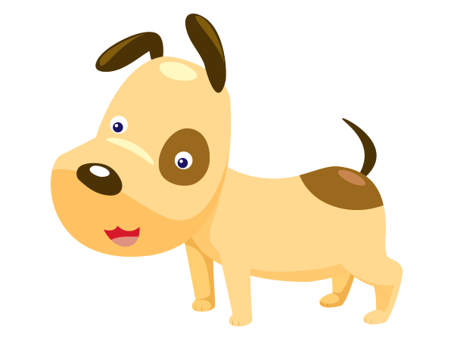
6. What Made This Sound?
Kitten
Puppy
Baby
Notes:
“What Sound Is It?”
Audio files for use with the activity, “Our Sense of Hearing,” from The Learning Brain project’s K–1: The Senses Teacher’s Guide.
Reference
Tharp, B., M. Vu, D. Mock, C. Burnett, and N. Moreno (2015). K-1: The Senses Teacher’s Guide. Baylor College of Medicine. ISBN: 978-1-888997-87-3. Development of The Learning Brain educational materials was supported by grant number 5R25DA033006 from the National Institutes of Health, NIH Blueprint for Neuroscience Research Science Education Award, National Institute on Drug Abuse (NIDA), administered through the Office of the Director, Science Education Partnership Award program.
Image References
Baby © Kchung.
Cat, dog © Sarawut Padungkwan.
Key Words
ear, hear, hearing, sound, senses,
“What Sound Is It?” © Baylor College of Medicine.

Slide 8
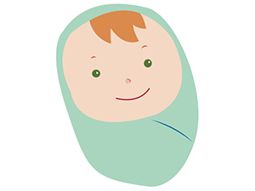
Answers
1.
4.
2.
5.
3.
6.
Notes:
“What Sound Is It?”
Audio files for use with the activity, “Our Sense of Hearing,” from The Learning Brain project’s K–1: The Senses Teacher’s Guide.
Answers
Ice cream truck
Duck
Beach
Fire truck
Recess
Baby
Extending the Lesson
Show a picture of a zoo. Ask students to think about sounds they have heard at the zoo, and then share those sounds with the class.
Group the class into teams of four students, and provide a different “sound setting” image (collected during setup) to each group. Each image should depict a scene or location where many different sounds can be heard. Explain to
students that they will create sounds to accompany their pictures. Allow five minutes for them to brainstorm and practice their sounds.
Have each group share its sounds with the class, without identifying their setting. After each presentation, ask the other groups to guess where the sounds might be heard. After several attempts, have the presenting group show its image to the rest of the class.
Close by reminding students that all or their senses are controlled by the brain.
Have students write one or two sentences about what they learned about sound from this activity.
Reference
Tharp, B., M. Vu, D. Mock, C. Burnett, and N. Moreno (2015). K-1: The Senses Teacher’s Guide. Baylor College of Medicine. ISBN: 978-1-888997-87-3. Development of The Learning Brain educational materials was supported by grant number 5R25DA033006 from the National Institutes of Health, NIH Blueprint for Neuroscience Research Science Education Award, National Institute on Drug Abuse (NIDA), administered through the Office of the Director, Science Education Partnership Award program.
Image References
Baby © Kchung. Beach © Iimages. Duck © Sarawut Padungkwan. Recess © Lorelyn Medina. Vehicles © Siamphotos.
Key Words
ear, hear, hearing, sound, senses,
“What Sound Is It?” © Baylor College of Medicine.

